Slide 1

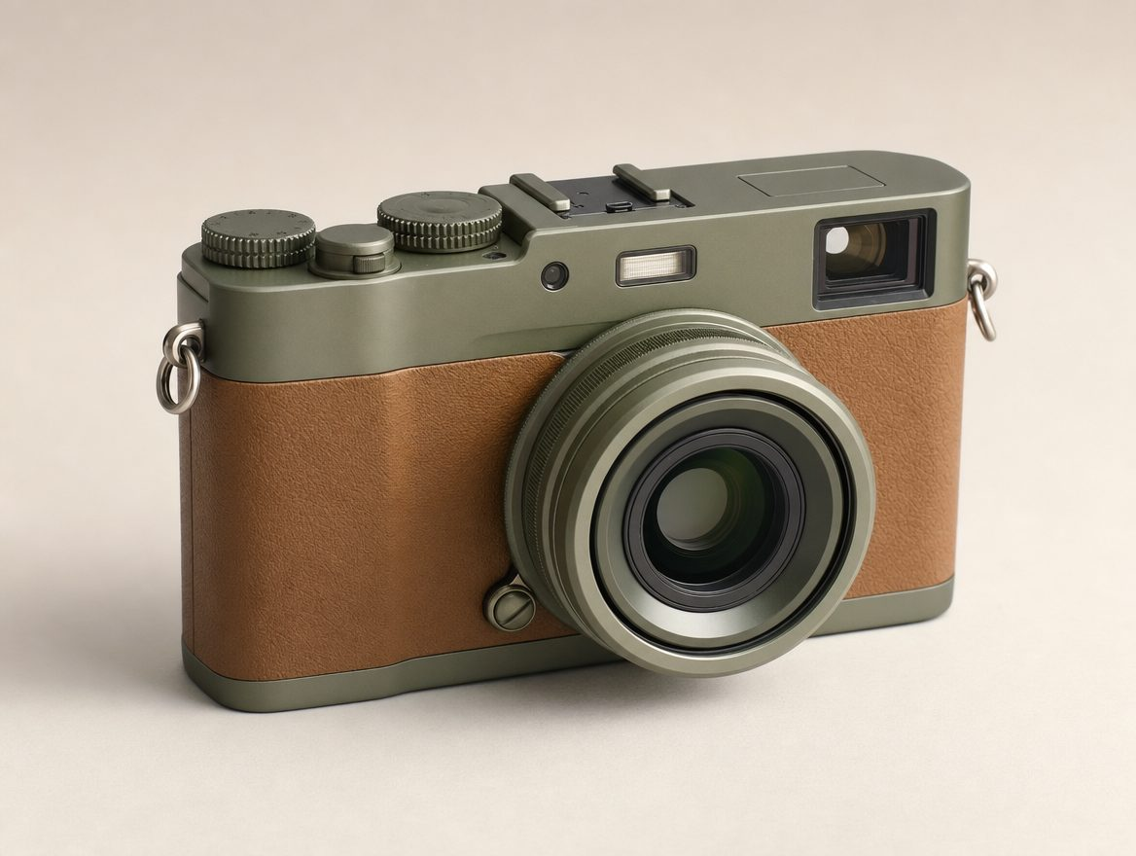
Fernweh Wayfarer
A travel camera for people who want the photo, not the feed.
Fernweh

Slide 2
Why now
Phone cameras are good enough that the gap is no longer image quality — it's attention
1,400 units pre-sold before a single ad ran
CAC of $38 against a $249 AOV
Fernweh

Slide 3
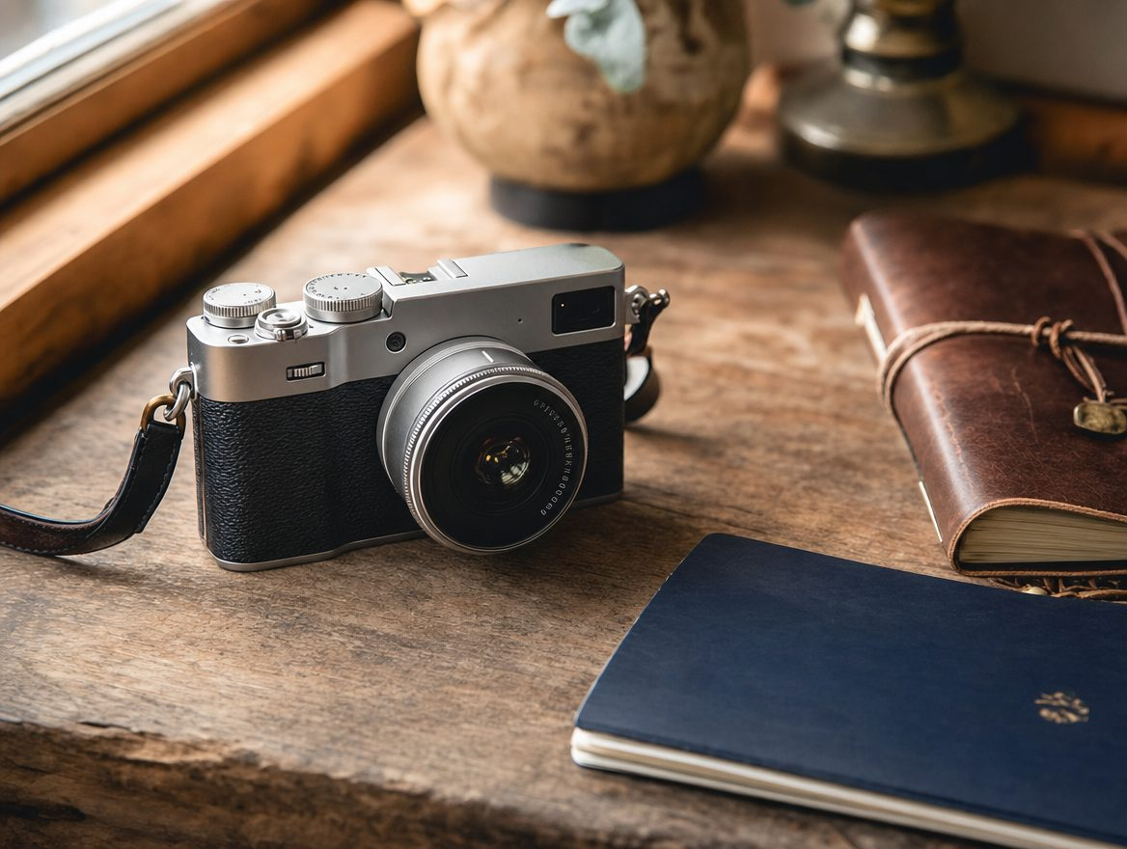
The product
Fernweh

Slide 4
The ask
Raising $1.2M to fund the second production run
18-month runway at current burn
Use of funds: inventory (60%), team (25%), marketing (15%)
Fernweh

